Slide 1
Webinar will begin soon
Public Health Goal Report 2022
gswater.com

Slide 2
Golden State Water Company
Public Health Goal Report 2022
gswater.com
Rocio Flores
Associate Water Quality Engineer -- Orange County District
October 2022​
1

Slide 3
Introductions
Samantha Chen
David Schultise
Rocio Flores
Water Quality Manager
Water Quality Engineer -- Southwest District
Associate Water Quality Engineer -- Orange County District
gswater.com
2

Slide 4
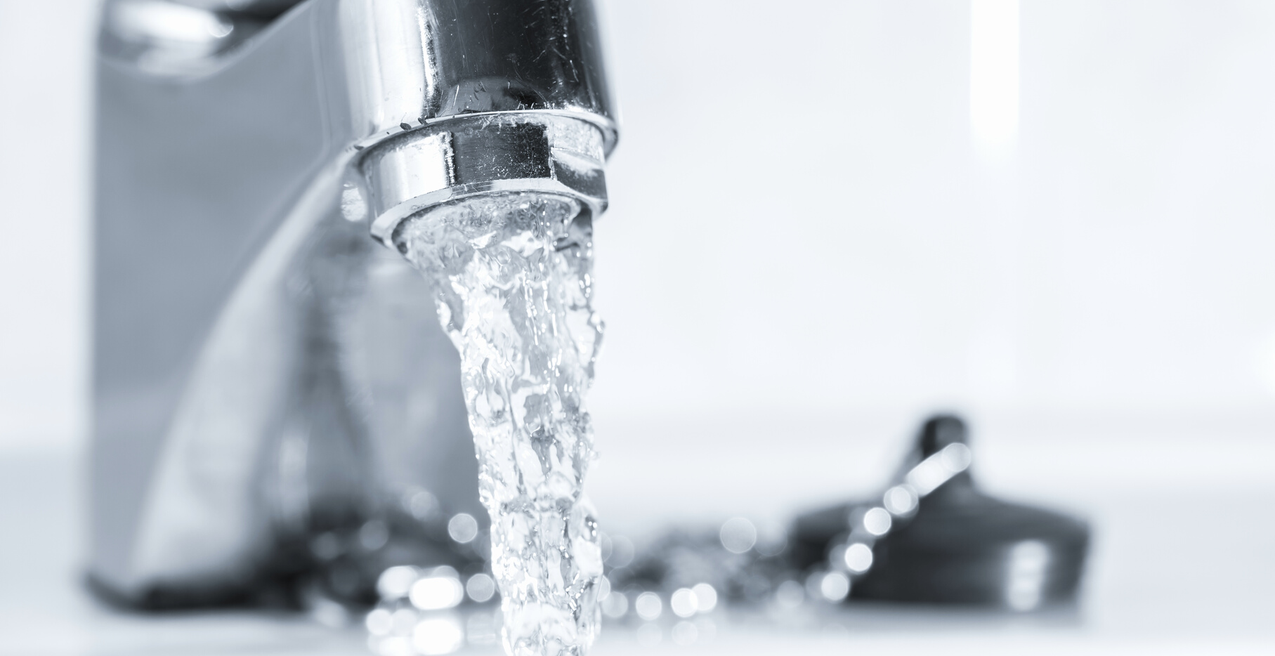
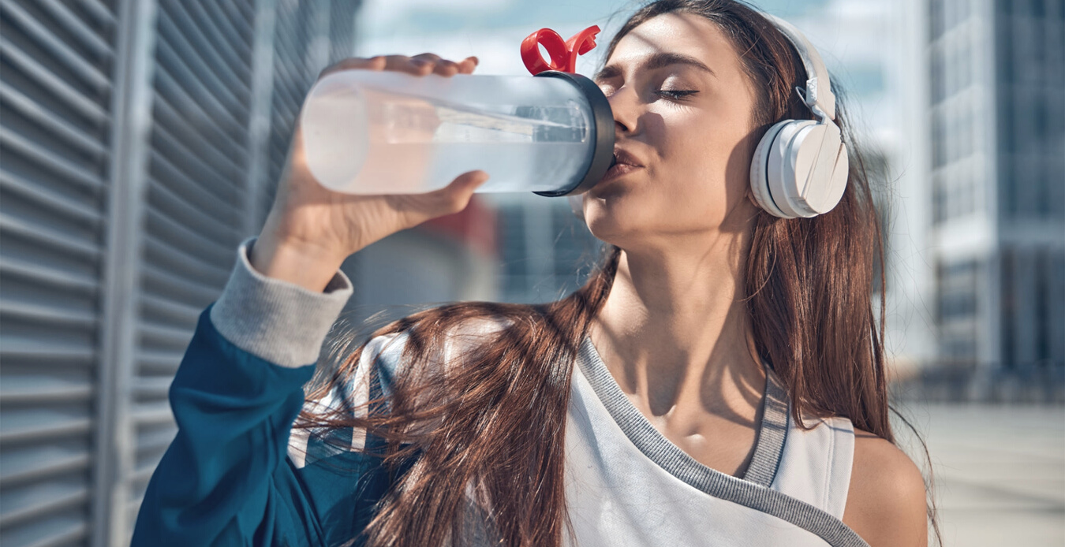
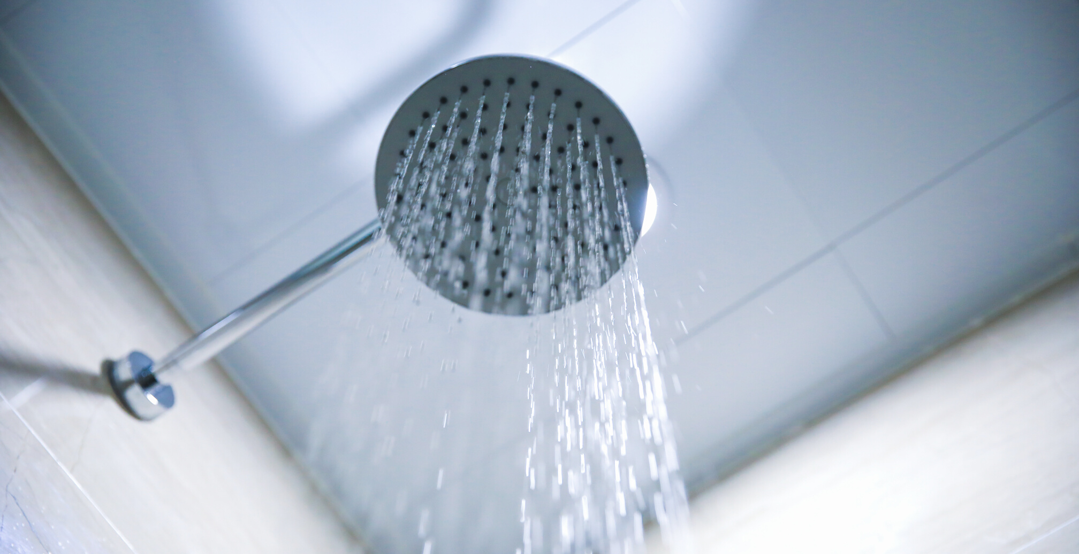
Overview
Company Background
Commitment to Water Quality
Purpose of Public Meeting
Public Health Goals
Constituents
Treatment Costs
Questions
gswater.com
3

Slide 5
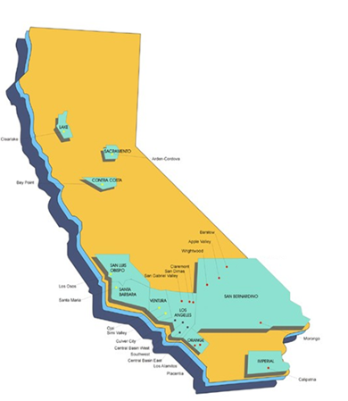
Golden State Water Company
Subsidiary of American States Water Company
Providing water service since 1929
Team of more than 500 water professionals delivers reliable, high-quality water that meets all state and federal drinking water standards
Provides water service to approximately 1 million customers in more than 80 communities throughout California
gswater.com
4

Slide 6
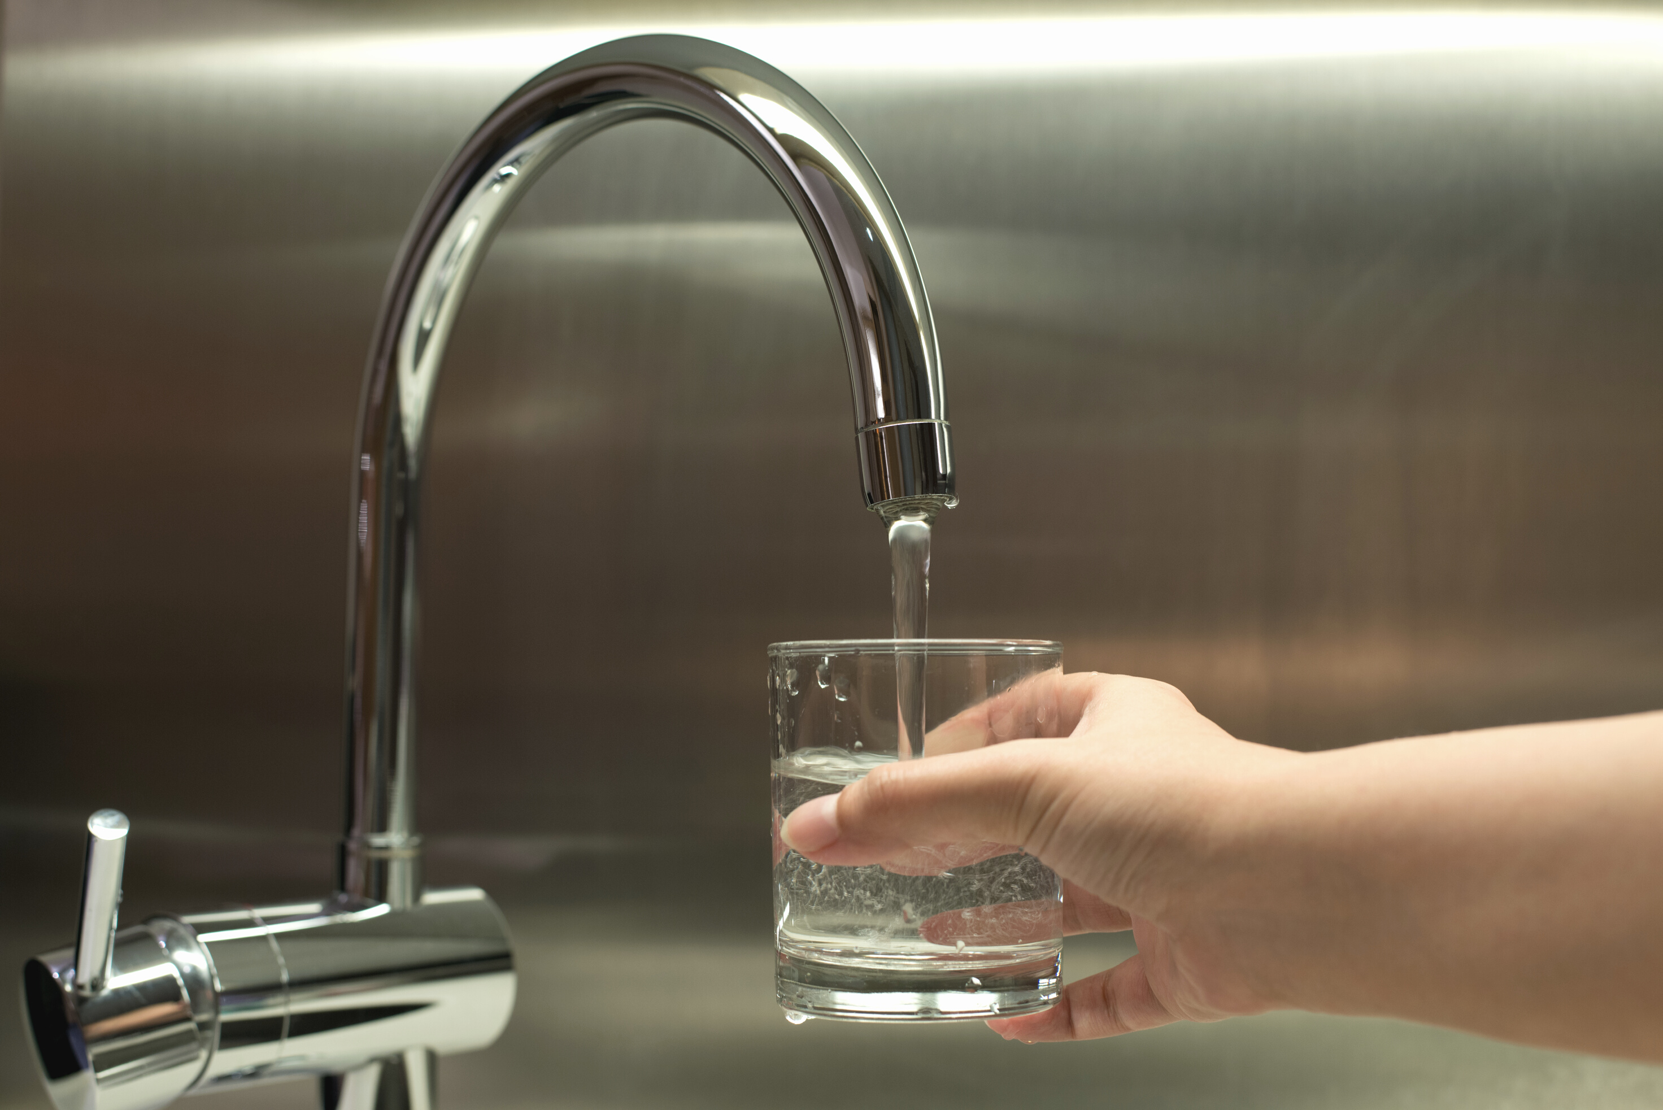
Commitment to Water Quality
Maintaining high-quality water and reliable service is a high priority for Golden State Water (GSW)
The water delivered to your tap continues to meet all federal and state quality standards established to protect public health and safety.
GSW does not serve water that contains contaminants in violation of recognized and enforceable Maximum Contaminant Levels (MCLs).
Water Quality data can be found in your Consumer Confidence Report www.gswater.com/annual-water-quality-reports
gswater.com
5

Slide 7
What are Public Health Goals?
Public Health Goal (PHG) – The level of a contaminant in drinking water below which there is no known or expected risk to health
Non-enforceable goals
Established by California EPA’s Office of Environmental Health Hazard Assessment (OEHHA)
gswater.com
6

Slide 8
What are Public Health Goals?
Maximum Contaminant Level Goal (MCLG) – the level of a contaminant in drinking water below which there is no known or expected risk to health. Established by US EPA
Maximum Contaminant Level (MCL) – the highest level of a contaminant that is allowed in drinking water. Primary MCLs are set as close to the public health goals and maximum contaminant level goals as is economically and technologically feasible.
gswater.com
7

Slide 9
What are Public Health Goals?
Water agencies are required to publicly disclose information on levels of contaminants even below the enforceable mandatory Maximum Contaminant Levels (MCLs)
Must disclose the estimated cost of reducing the contaminant regardless of minimal risk
Findings are presented at a publicly noticed meeting and at www.gswater.com/annual-water-quality-reports
gswater.com
8
Notes:
Please update link to take customers to PHGs website. This is the annual reports (consumer confidence reports).

Slide 10
Public Health Goal Reports
California Health and Safety Code Section 116470(b) requires larger water utilities (>10,000 connections) to prepare a special report every 3 years on water quality measurements that exceed a PHG
Requires water suppliers to use the MCLG where OEHHA has not established a PHG
2022 PHG Report uses data from 2019 - 2021
gswater.com
9

Slide 11
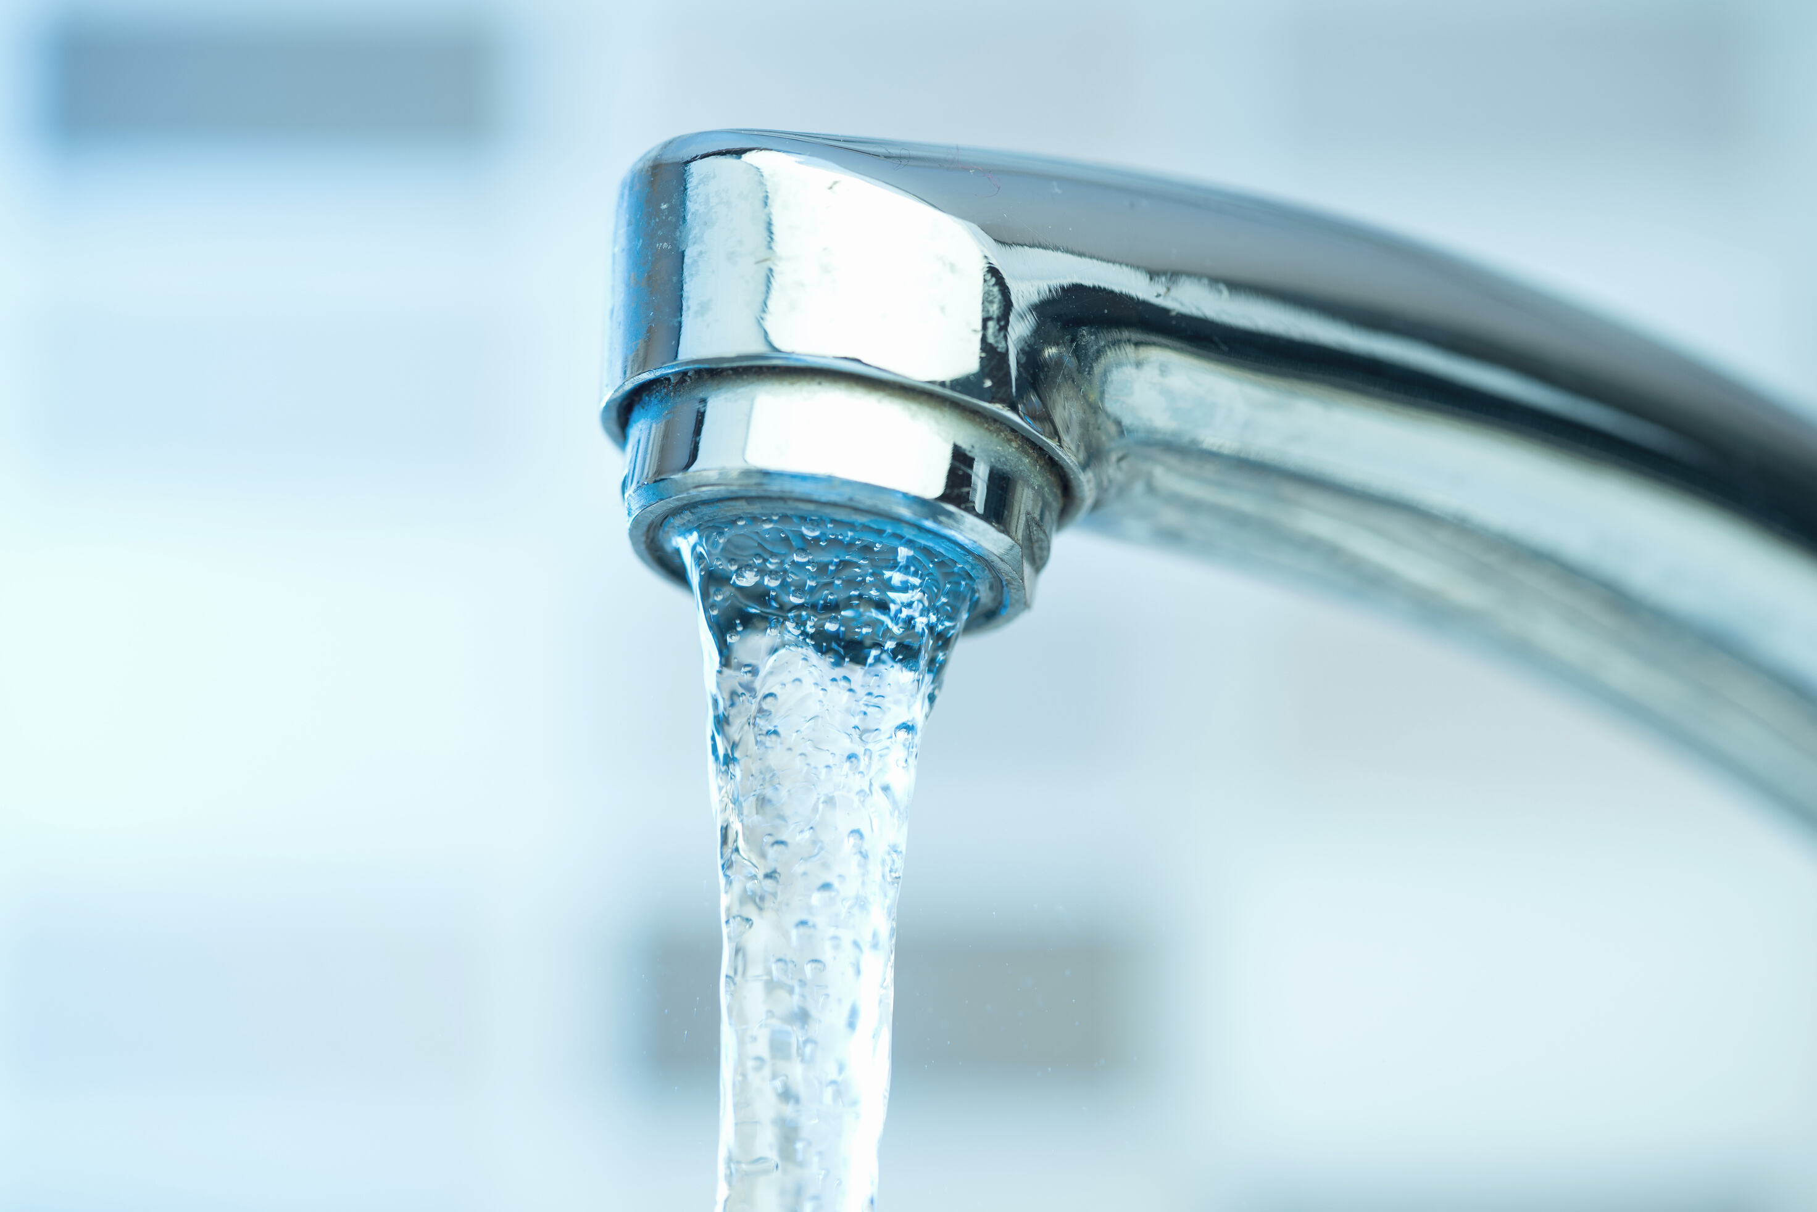
Service Areas
Artesia
Claremont
Orcutt
Most residents of Artesia and Hawaiian Gardens
Parts of Lakewood, Los Alamitos, Long Beach, and Cerritos
Claremont
Orcutt
Cordova
Rancho Cordova
Gold River
West Orange & Placentia Yorba Linda
gswater.com
Simi Valley
Southwest
Simi Valley
Southwest Los Angeles County
Gardena
Lawndale
Portions of Carson, Compton, El Segundo, Hawthorne, Inglewood, Redondo Beach
Unincorporated Athens, Del Aire, El Camino, Village Lennox, and Gardena Heights
Los Alamitos
Cypress
Stanton
Small portions of the cities of Garden Grove, La Palma, Buena Park and Seal Beach
Placentia
Yorba Linda
10

Slide 12
Constituents
Arsenic
PHG level – 4 nanograms per liter (ng/L)
MCL is 10 µg/L
Best Available Technologies (BATs) to remove arsenic include activated alumina, ion exchange, lime softening, coagulation/filtration, and reverse osmosis (RO)
Most effective and consistent method to remove arsenic to below the PHG is RO
Southwest, Artesia, West Orange, Claremont, Simi Valley, Orcutt, Cordova
gswater.com
11

Slide 13
Constituents
Tetrachloroethylene (PCE)
PHG level – 0.06 micrograms per liter (µg/L)
MCL is 5 µg/L
BATs to remove PCE include granular activated carbon (GAC) and packed tower aeration
Most effective and consistent method to remove PCE to below the PHG is GAC
Artesia, Cordova
gswater.com
12

Slide 14
Constituents
Trichloroethylene (TCE)
PHG level – 1.7 micrograms per liter (µg/L)
MCL is 5 µg/L
BATs to remove TCE include GAC and packed tower aeration
Most effective and consistent method to remove TCE to below the PHG is GAC
Cordova
gswater.com
13

Slide 15
Constituents
Dibromochloropropane (DBCP)
PHG level – 3 micrograms per liter (µg/L)
MCL is 200 µg/L
BATs to remove DBCP include GAC and packed tower aeration
Most effective and consistent method to remove DBCP to below the PHG is GAC
Claremont
gswater.com
14

Slide 16
Constituents
Uranium
PHG level – 0.43 pico-Curies per liter (pCi/L)
MCL is 20 pCi/L
BATs to remove Uranium include ion exchange, RO, lime softening, or coagulation/filtration
Most effective and consistent method to remove uranium to below the PHG is RO
Southwest, Artesia, Placentia Yorba-Linda, West Orange, Claremont, Simi Valley, Orcutt
gswater.com
15

Slide 17
Constituents
Bromate
PHG level – 0.1 micrograms per liter (µg/L)
MCL is 10 µg/L (Based on a running annual average)
BATs to remove bromate include reduction of naturally occurring organic matter (NOM). Since bromate is found in our purchased water this can not be accomplished
Most effective and consistent method to remove bromate to below the PHG is RO
Southwest, Placentia Yorba-Linda, West Orange
gswater.com
16

Slide 18
Constituents
Perchlorate
PHG level – 1 micrograms per liter (µg/L)
MCL is 6 µg/L
BATs to remove perchlorate include ion exchange and biological treatment
Most effective and consistent method to remove perchlorate to below the PHG is ion exchange
Placentia Yorba-Linda, West Orange, Claremont, Cordova
gswater.com
17

Slide 19
Constituents
Gross Alpha Particle Activity
MCLG level – 0 pico-Curies per liter (pCi/L)
MCL is 15 pCi/L
BATs to remove gross alpha include RO
Most effective and consistent method to remove gross alpha to below the PHG is RO
Southwest, West Orange, Claremont, Simi Valley, Orcutt
gswater.com
18

Slide 20
Constituents
Gross Beta Particle Activity
MCLG level – 0 millirem per year (mrem/yr)
MCL is 4 mrem/yr
BATs to remove gross beta include RO and ion exchange
Most effective and consistent method to remove gross beta to below the PHG is RO
Southwest, Placentia Yorba-Linda, West Orange, Claremont
gswater.com
19

Slide 21
Constituents
Fluoride
PHG level – 1 milligrams per liter (mg/L)
MCL is 2 mg/L
Fluoride is added as a regulatory requirement. The optimal level set by EPA is 0.7 mg/l
No treatment is proposed for this constituent
Southwest, Orcutt
gswater.com
20

Slide 22
Constituents
Lead
PHG level – 200 nanograms per liter (ng/L)
MCL is 15 µg/L
BATs to remove lead include RO
Most effective and consistent method to remove lead to below the PHG is RO
Orcutt
gswater.com
21

Slide 23
Summary of Detections
System Name | Arsenic (µg/L) | PCE (µg/L) | TCE (µg/L) | DBCP (ng/L) | Uranium (pCi/L) | Bromate (µg/L) | Perchlorate (µg/L) | Gross Alpha (pCi/L) | Gross Beta (pCi/L) | Fluoride (mg/L) | Lead (ng/L)
Southwest | 3 |  |  |  | 3 | 9.8 |  | 9.9 | 7 | 2
Artesia | 16* | 0.66 |  |  | 2.8
Placentia /Yorba Linda |  |  |  |  | 6 | 5.9 | 3.9 |  | 7
West Orange | 5 |  |  |  | 15 | 5.9 | 3.7 | 4 | 7
Claremont | 5.6 |  |  | 26 | 3.3 |  | 3 | 13 | 3.82
Simi Valley | 1.3 |  |  |  | 5.5 |  |  | 14
Orcutt | 1 |  |  |  | 4.1 |  |  | 11 |  | 1.1 | 580
Cordova | 2.6 | 0.66 | 2.5 |  |  |  | 5.1
gswater.com
22
*Only one sample in 2021 had a detection above the MCL and the well was taken offline upon notification of the results. Compliance is based on the monthly average and it was below the MCL. Our water system is in full compliance with the drinking water standard for arsenic, but the arsenic level in the system at times exceeds the PHG.

Slide 24
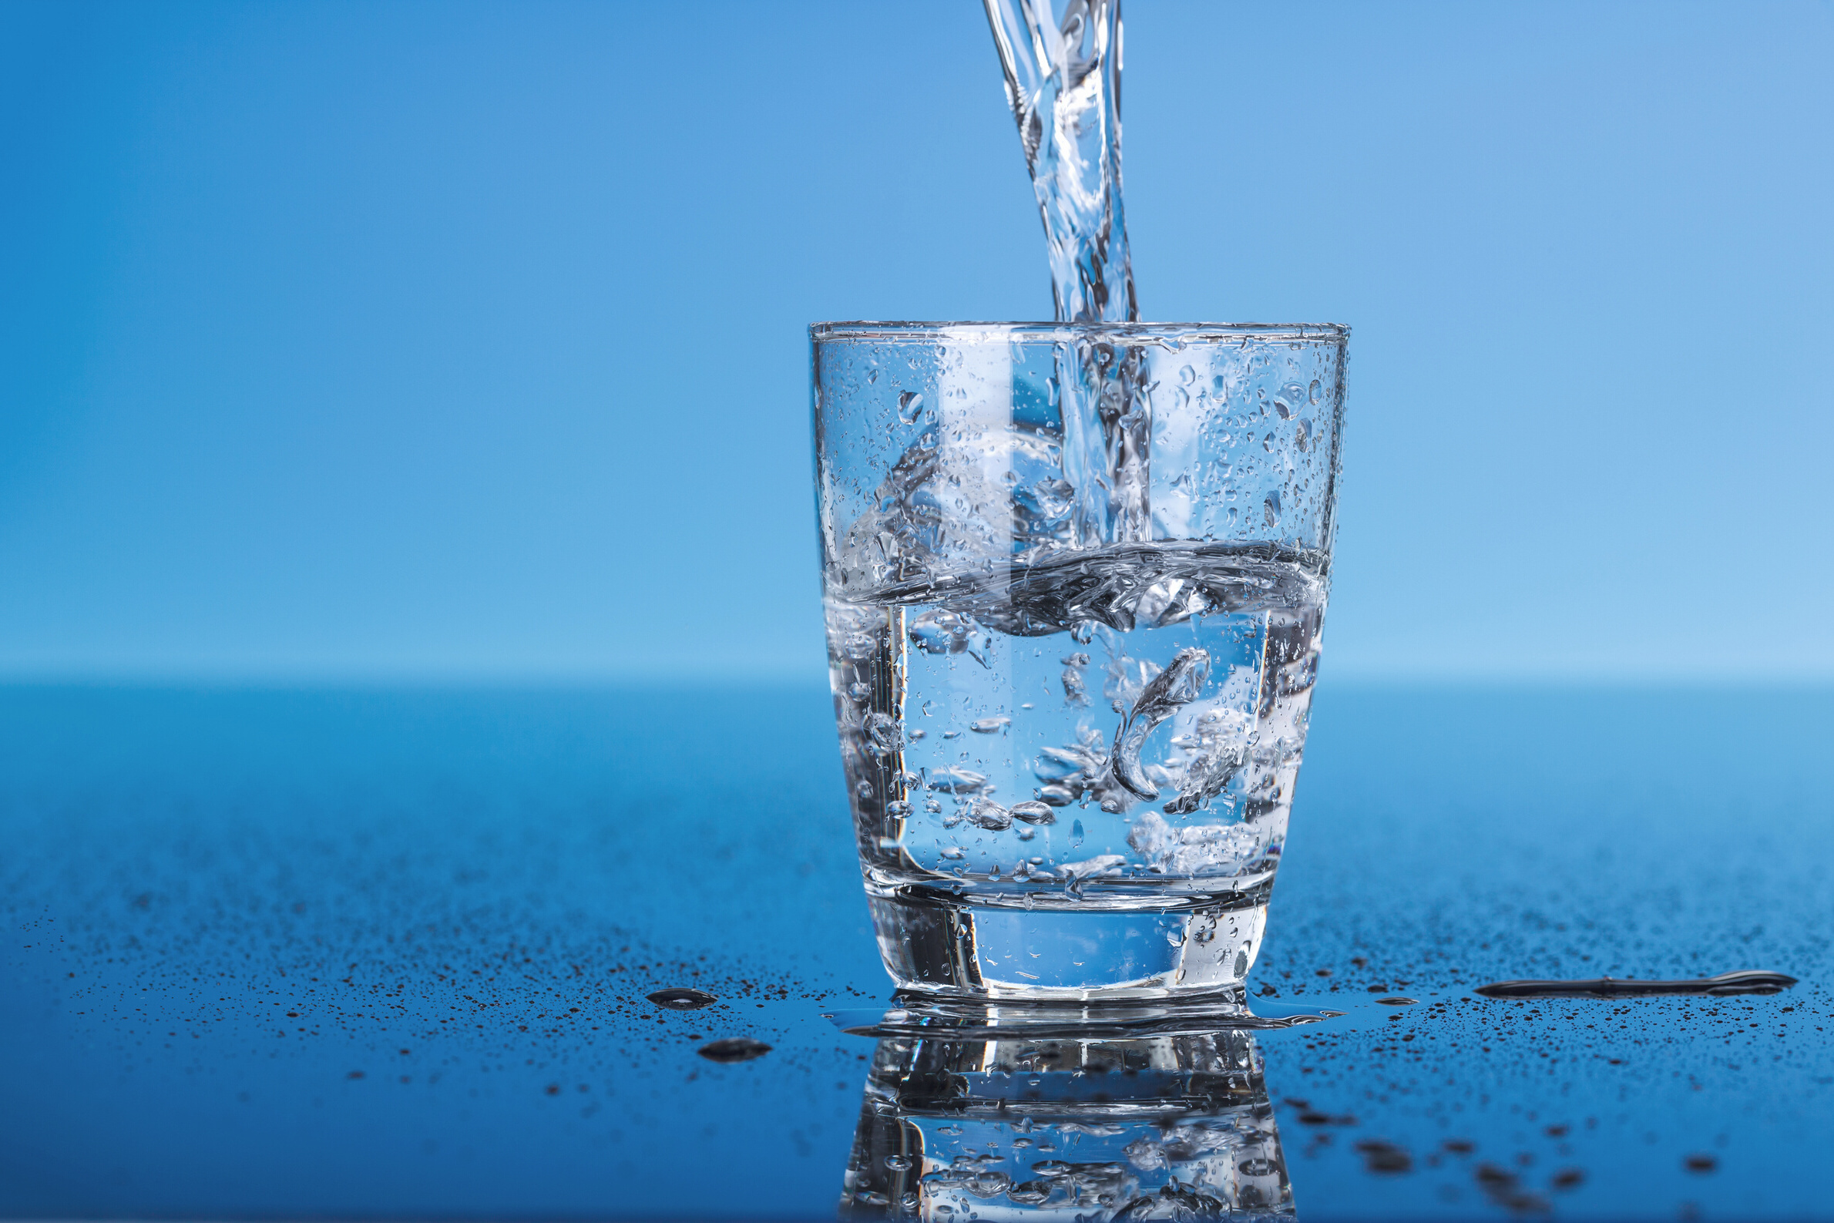
Treatment Selected
System Name | Arsenic | PCE | TCE | DBCP | Uranium | Bromate | Perchlorate | Gross Alpha | Gross Beta | Fluoride | Lead
Southwest | RO |  |  |  | RO | RO |  | RO | RO | N/A
Artesia | RO | GAC |  |  | RO
Placentia/ Yorba Linda |  |  |  |  | RO | RO | IX |  | RO
West Orange | RO |  |  |  | RO | RO | IX | RO | RO
Claremont | RO |  |  | GAC | RO |  | IX | RO | RO
Simi Valley | RO |  |  |  | RO |  |  | RO
Orcutt | RO |  |  |  | RO |  |  | RO |  | N/A | RO
Cordova | RO | GAC | GAC |  |  |  | IX
gswater.com
RO = Reverse Osmosis
GAC = Granular Activated Carbon
IX = Ion Exchange
23

Slide 25
Treatment Costs
Costs of treatment depend on several factors:
Type of treatment
Number of treatment facilities required
Number of contaminants to be removed
Number of treatment technologies required
Volume of water treated
gswater.com
24

Slide 26
Treatment Costs
System Name | No. of Sites | Annual Cost | Monthly Cost/Connection
Southwest | 14 | $77,800,818 | $124.95
Artesia | 8 | $15,828,412 | $122.77
Placentia/Yorba Linda | 6 | $33,392,512 | $216.02
West Orange | 17 | $66,398,081 | $198.79
Claremont | 13 | $13,609,364 | $99.64
Simi Valley | 1 | $3,422,667 | $21.13
Orcutt | 3 | $4,817,275 | $34.28
Cordova | 8 | $6,118,269 | $34.45
gswater.com
25

Slide 27
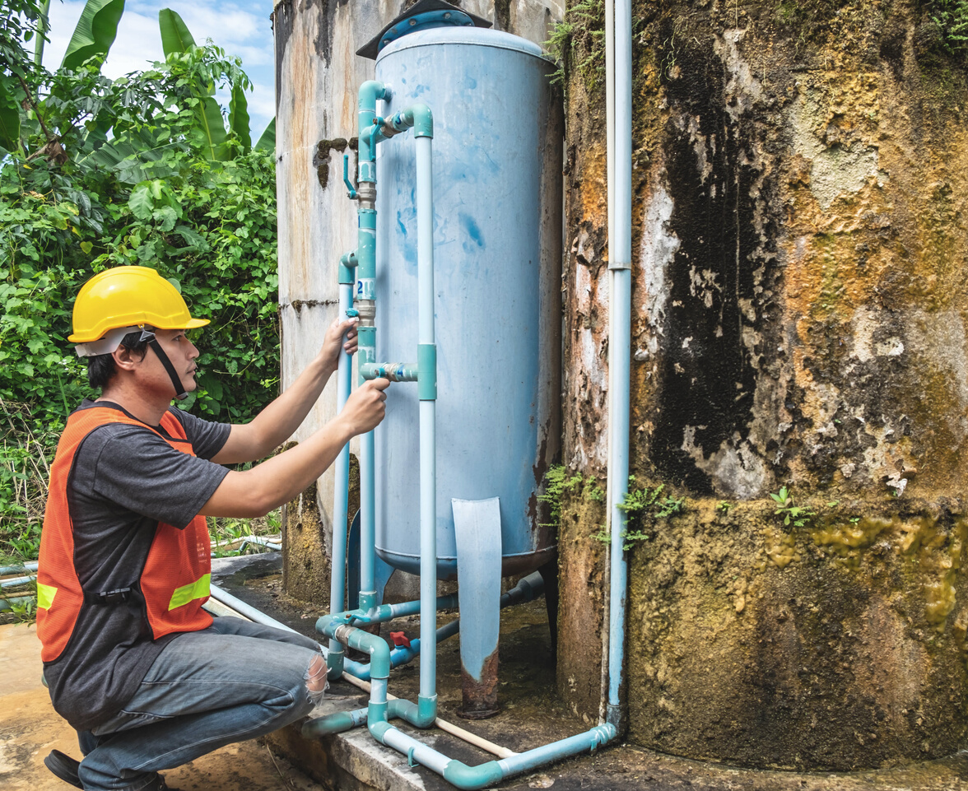
For Additional Information
Website
Gswater.com/conservation
Email
conservation@gswater.com
gswater.com
Facebook/Twitter
@GoldenStateH2O
Phone
800.999.4033
26

Slide 28
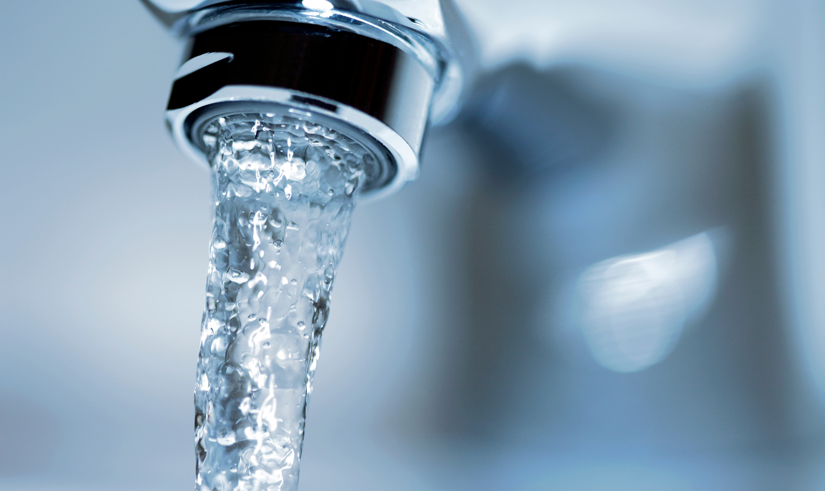
Golden State Water Company
Thank You Questions?
gswater.com
Gswater.com | 800.999.4033 | @GoldenStateH2O
www.gswater.com/post/2022-reports-public-health-goals

